Slide 1

Pre-Visit Lesson

Slide 2
TRAVEL Back TO 1793

Slide 3


Notes:
Video Link: https://youtu.be/b2haiYWLKS8

Slide 4
The Role of the Cabinet
The Cabinet is a group of the President's top advisors.
President Washington created the first cabinet positions to advise on problems of the country.

Slide 5
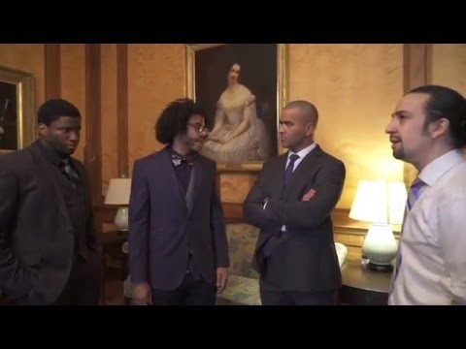
Debate over Debt
Notes:
Video Link: https://youtu.be/A1mYfsNFtGI

Slide 6
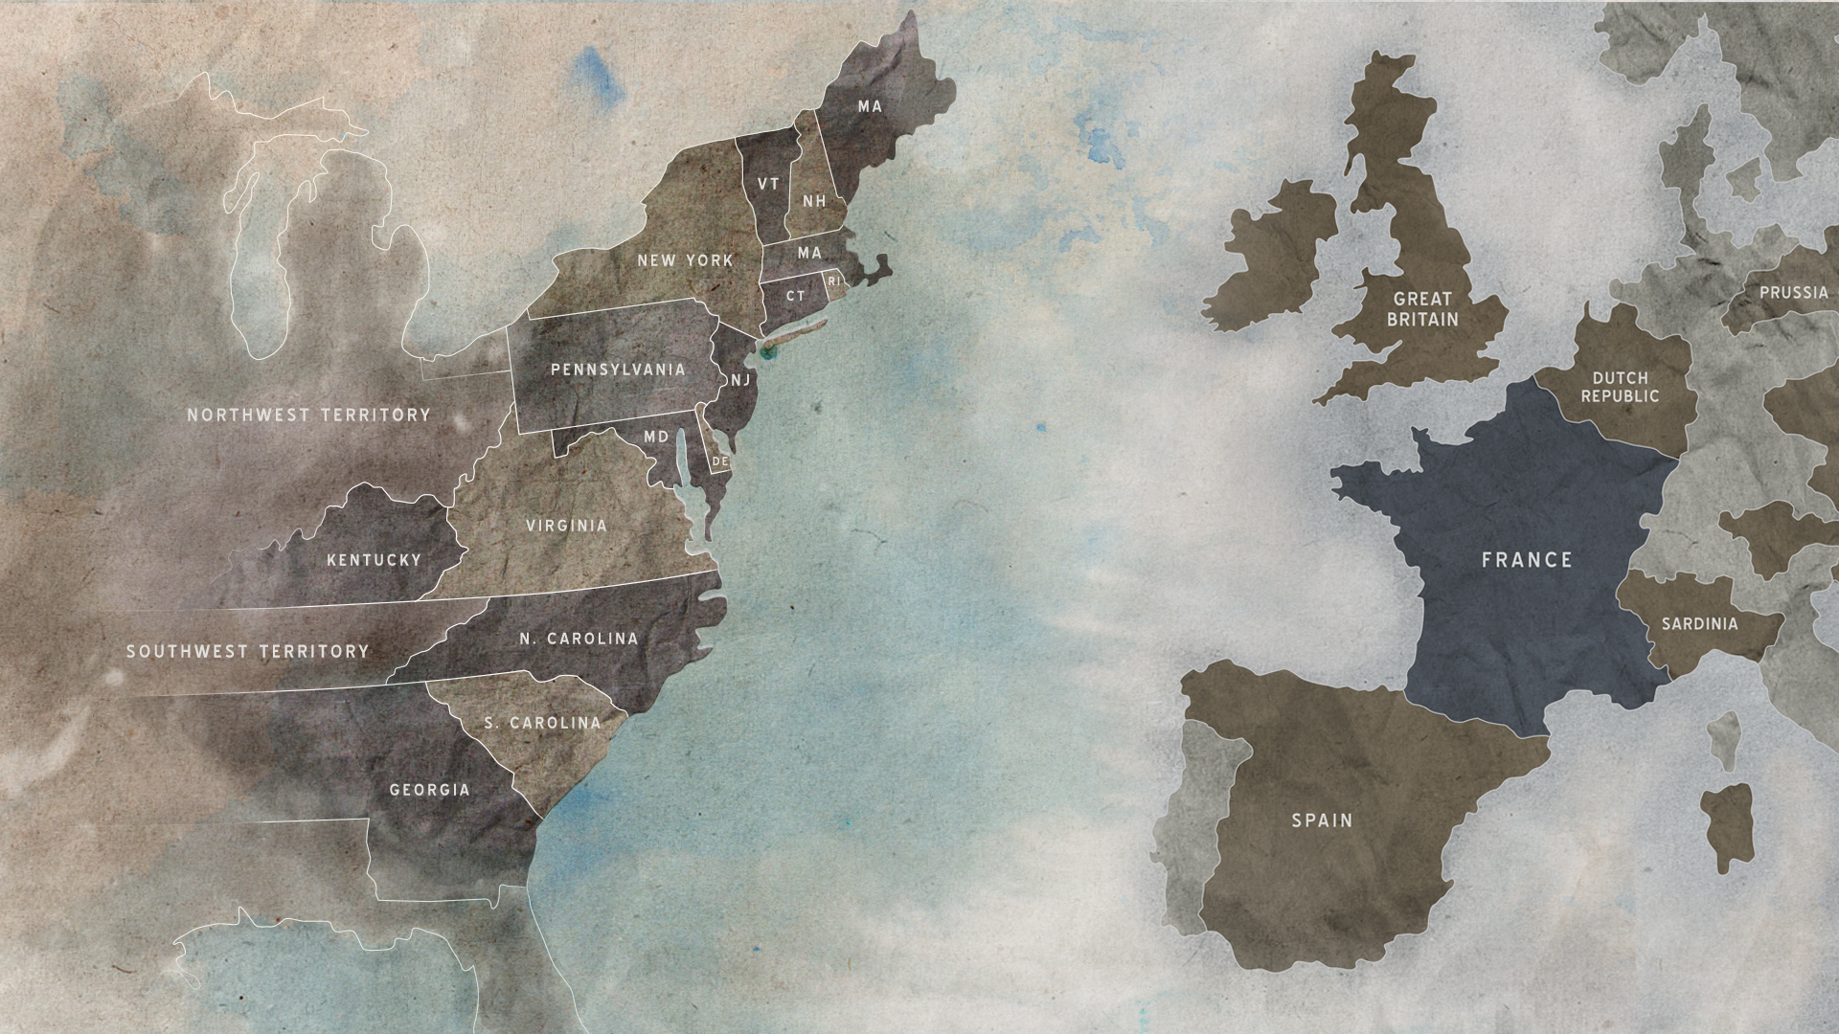
The Nations of 1793

Slide 7
Types of Neutrality
Military Neutrality
Economic Neutrality
Strict Neutrality

Slide 8
Military Neutrality
A country is against sending troops or military aid to a war effort.
A country that is militarily neutral may or may not have an army ready to defend itself from attack.

Slide 9
Economic Neutrality
A country can remain militarily neutral and still continue to trade goods with other nations involved in war.

Slide 10
Strict Neutrality
NOT TAKING SIDES
This includes refraining from sending troops or weapons to either side of a war.

Slide 11
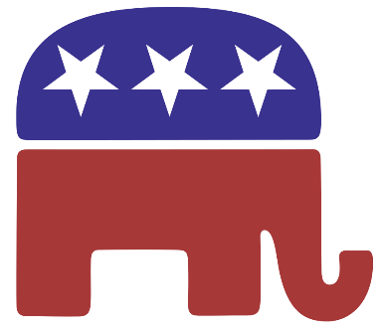
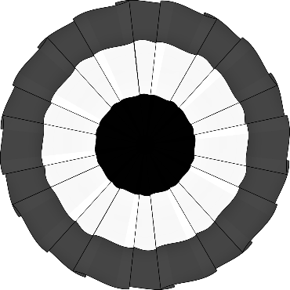
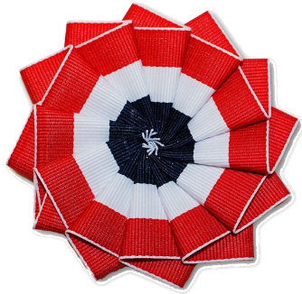
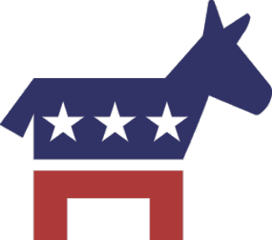
Choosing a side
Before elected representatives vote on a bill, they consult with their political party (A group of people who share the same beliefs about the way the country should be run).
Today
1793
Federalist
Democratic-Republican

Slide 12
Moderate
Some Senators believed that creating political parties was a bad idea, and refused to join either side.
They were known as MODERATES.

Slide 13
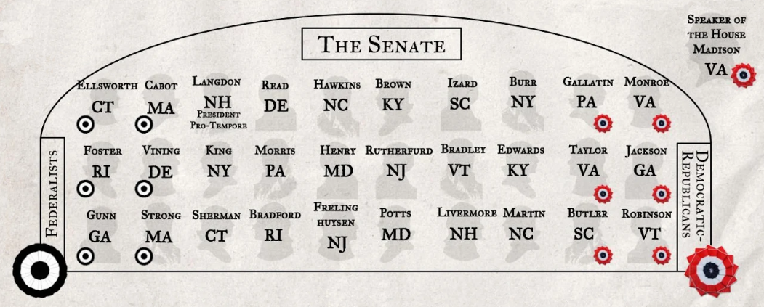
The Map of Your Senate

Slide 14
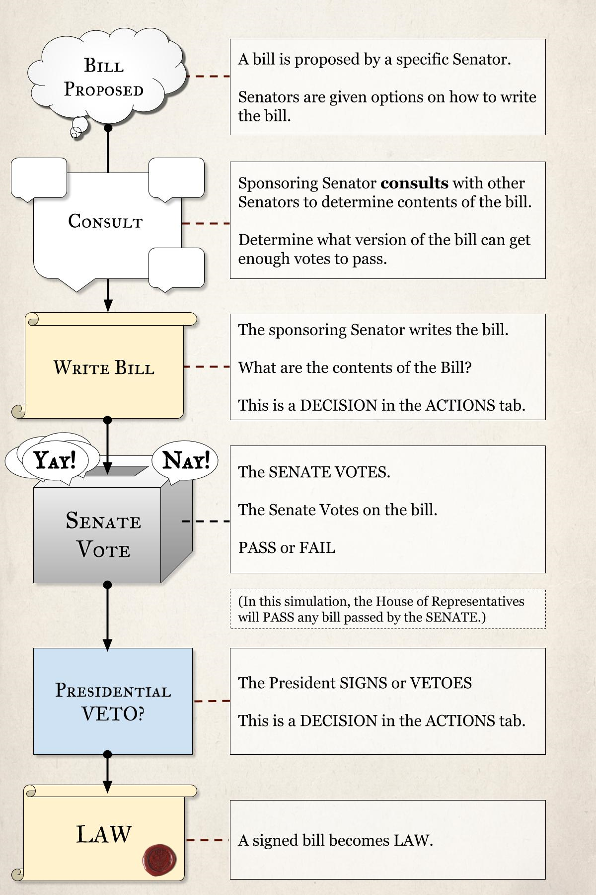
Create Laws
Senators and Members of the House of Representatives propose written ideas for laws, called bills, that they hope will one day become law.

Slide 15
Veto
The President can VETO(deny) any law by Congress.
Congress can reject the Veto if two thirds of congress agrees to keep the bill.

Slide 16
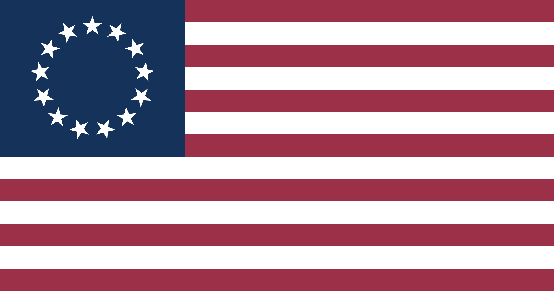
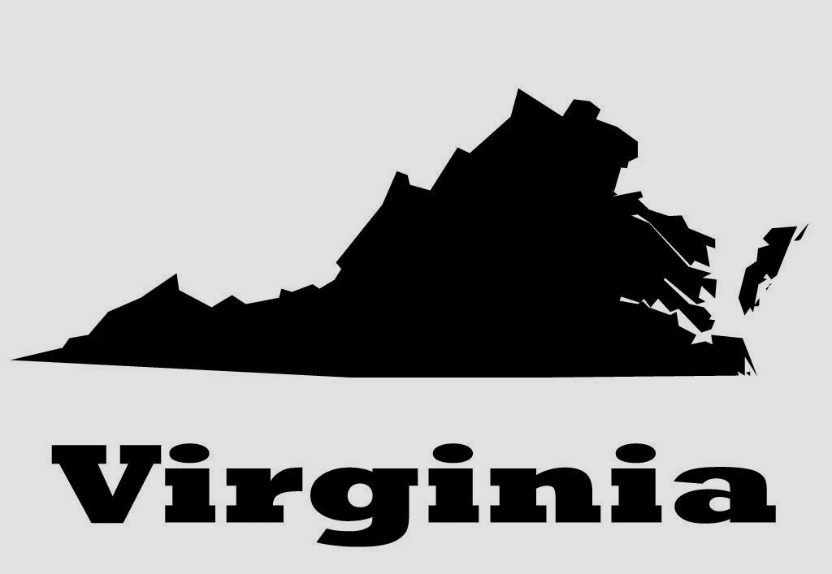
Country or State?
Senators have to decide whether to prioritize the immediate interests of their state or focus on what is best for the new nation as a whole.
Sometimes these things are the same, and sometimes they are not.
Voting

Slide 17
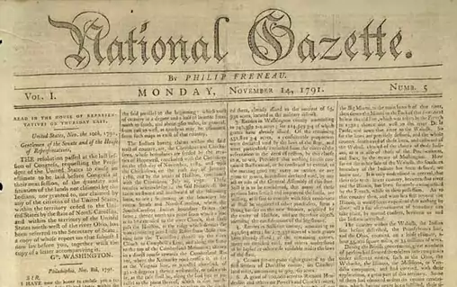
The Power of the Press

Slide 18
The Power of the Written Word
In 1793 there was no Social Media, email, or television.
People depended on newspapers to know what was happening outside of their homes.

Slide 19
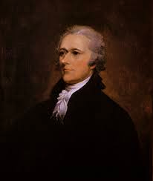
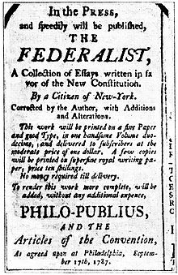
Is That Your Real Name?
Members of the government would use fake names (Pseudonyms) to write stories and opinions.
Alexander Hamilton, for example, used the name “Caesar” to author his Federalist Papers.

Slide 20
Truth or Lies?
Newspaper authors had the freedom to print their opinions on the country and president.
With limited access to other news sources, Americans would meet with each other at pubs and coffee houses to discuss current events.

